Slide 1
Lending Club Case Study
Presented by
Rajaa C

Slide 2
Problem Statement
A consumer finance company which is one of the largest market place specializing in lending various types of loans to urban customers.
To find the consumer attributes & loan attributes which influence the tendency of default.
To Identify the driving factors & strong indicators of default.

Slide 3
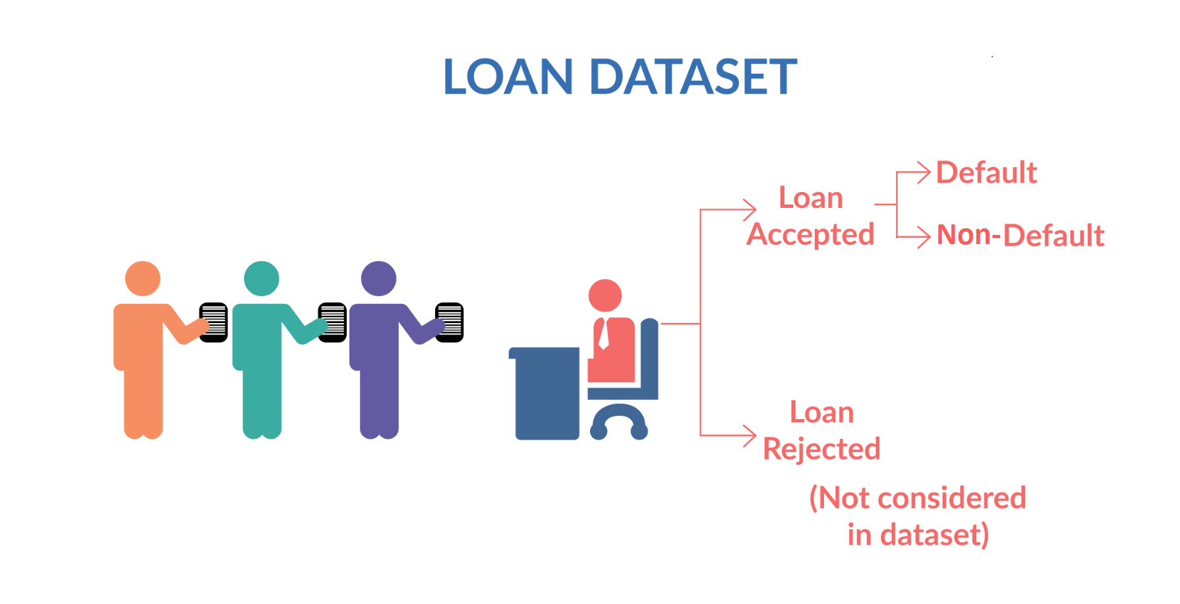
Understanding the Data Set

Slide 4
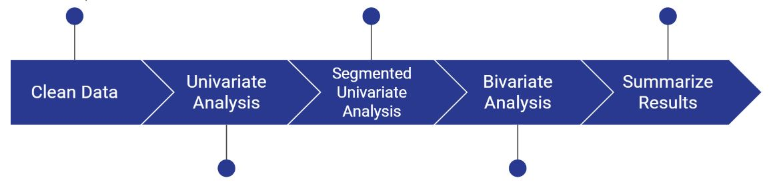
Approach to the Analysis

Slide 5
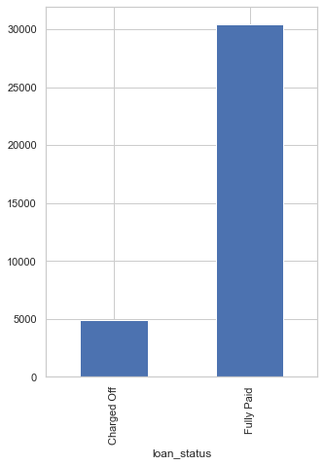
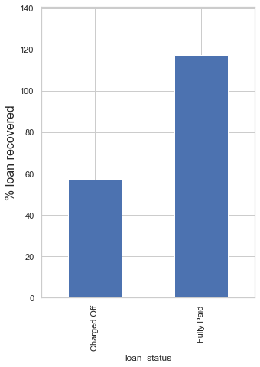
Status of the loans
Around 1/6 th of the loan taken are defaulted
Only half the loans are recovered when the loan is defaulted.

Slide 6
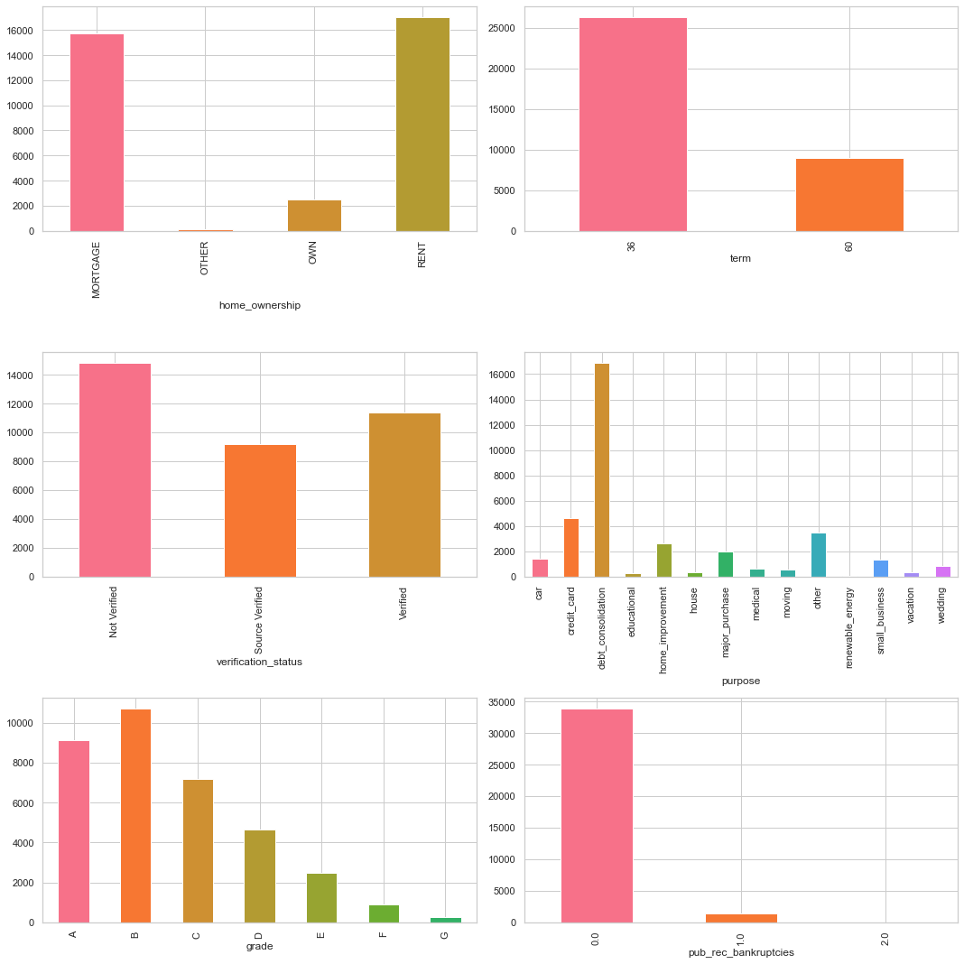
Most loans are for 36 month term
Very few loans are extended to people with prior record of bankruptcy
Most approved loans are high grade

Slide 7
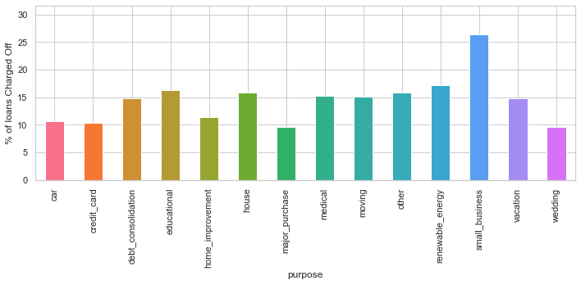
Most of the loans are issued for the small business.
Next significant amount of loans are issues for renewable energy, Educational & debt consolidation.

Slide 8
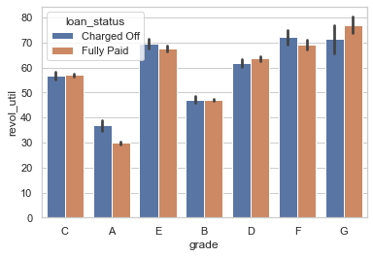
Higher loan amount are associated with higher grades.

Slide 9
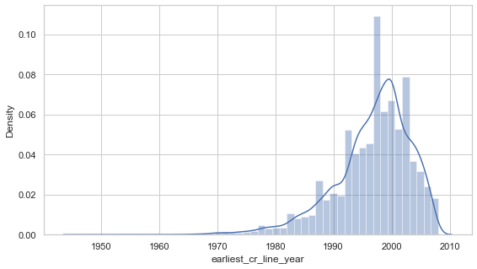
Most of the analyzed loan applicants have 2000 as the year of earliest credit line.

Slide 10
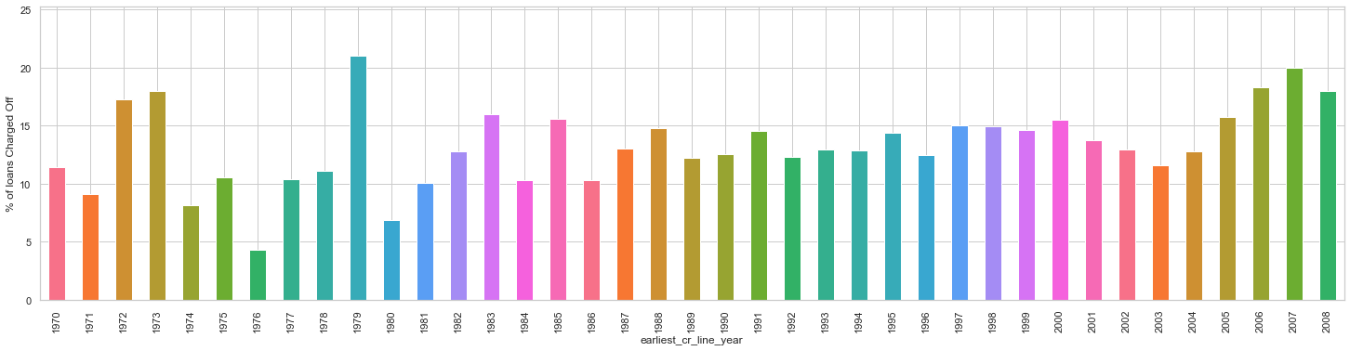
Newer applicants are defauling more often.
In [ ]:
​
Newer applicants are defauling more often.
In [ ]:
​
Newer Applicants are defaulting more often

Slide 11
Recommendations
Reduce approving loans when amount/loan is greater than 30%.
Stop approving high value loans when line utilization rate of greater than 75%
Reduce approvals for small business loans.
Stop approving high value loans to persons which bad record.

Slide 12
The End.

